Slide 1
Group 2 Presentation
Aishwarya Kadam, Aniket Tripathy, Akanksha Chauhan, Harshavardhan Yarlagadda, Gautham Sai MR
Ad Grants Online Marketing Challenge: The Center Seville
Campaign Start Date
Campaign End Date
23rd March, 2019
25th April, 2019
Main Objective
To create Brand Awareness and Cultivate Donors
USP of the Company
Provides Tuition Free Gap to students
Startup Based in
Seville, Spain

Slide 2
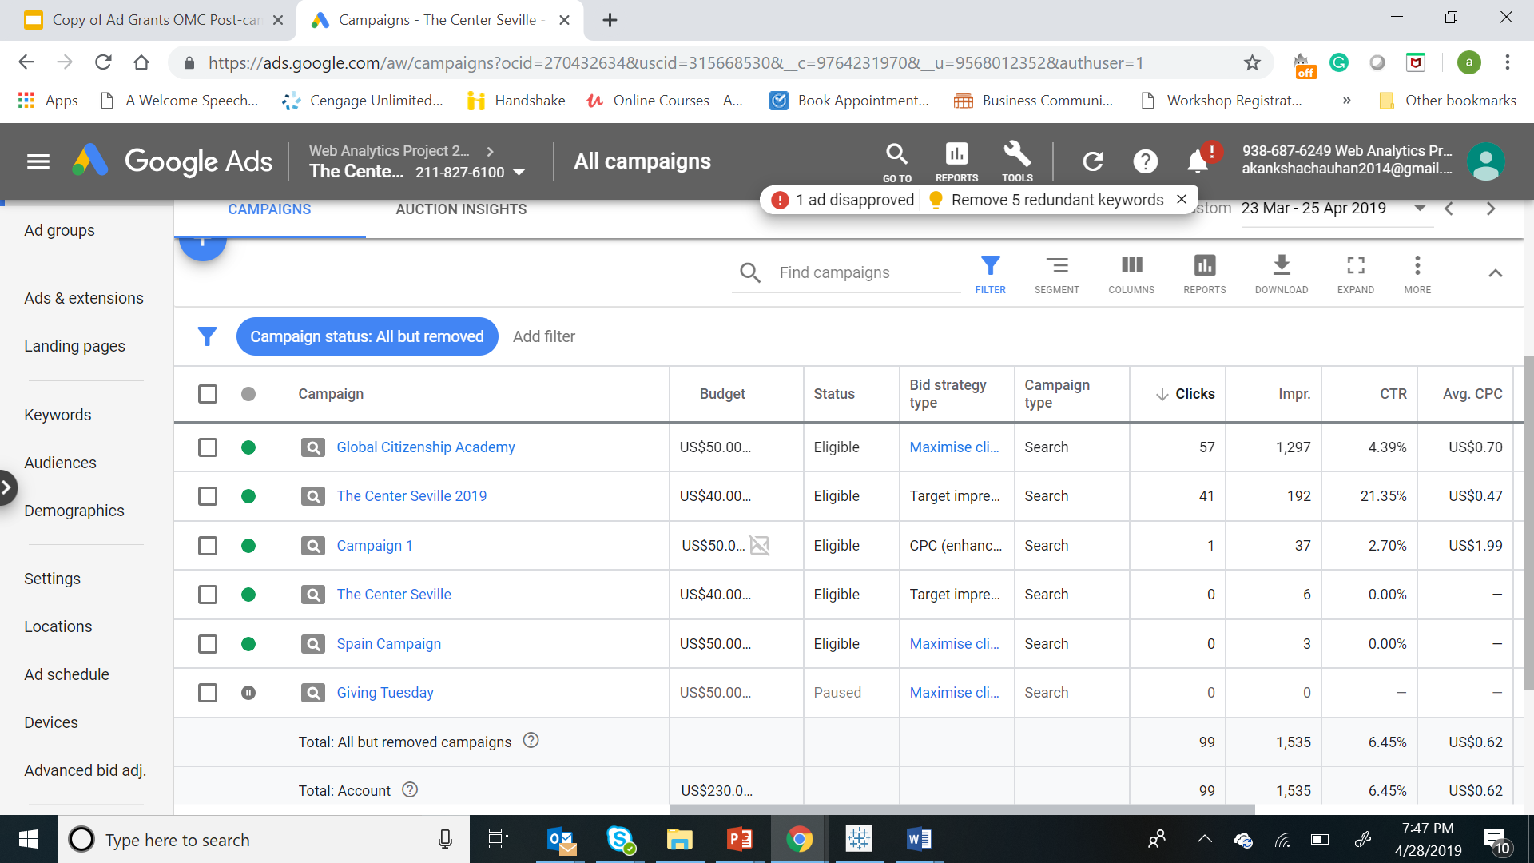

Our Main Focus:
To get clicks
To get Impressions
Improve CTR
Targeted Audience:
USA
Canada
Campaign Structure
BEFORE
AFTER

Slide 3
Strategies Used:
Campaign Highlights:
In 1st week, to see the performance of the campaign
In 3rd week, to get clicks after getting good number of impressions from 2nd week
Target Share Impression
Sitelinks
Maximize Clicks
Enhanced CPC
In 2nd week, to check if the number of impressions increased as compared to week 1
To check their performance on Campaign
Achieved a total of 6.6% CTR in the United States and around 6.5% in Canada.
Best Results from Center Seville 2019 campaign : CTR of 21.35%
With an average of 0 clicks for a week starting 24th March, 2019, we saw a peak on 31st of March, 2019, and then a constant average of 2 clicks per day till 25th of April, 2019

Slide 4
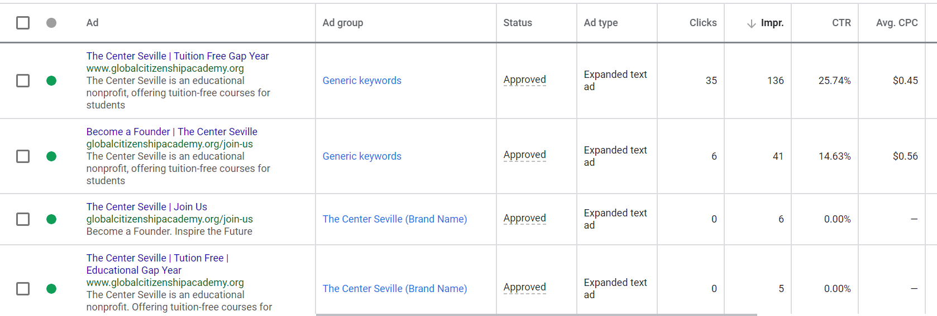
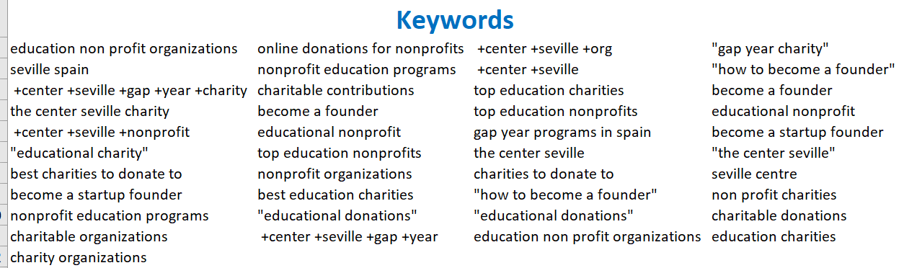
Campaign Design
What went wrong:
Generic Keywords which had very low search volume did not work
Broad Match Keyword triggered wrong ads, hence a list of Negative keywords were added after initial research
What Went well:
Never exceeded the per week budget of $95 for the non-profit organization as their budget for an entire year was $5000
Reached the targeted location of USA and Canada
Bidding Strategies worked well in both the regions

Slide 5
Campaign Overview
Campaign 1: The Center Seville 2019
No. of Clicks in USA: 29
No. of Clicks in Canada: 13
Cost from Mar. to Apr was $19.07
Avg CPC was $0.47
CTR: 23.16%
Allocated Budget: $40
Bidding Strategy used:
Maximize Clicks
Target Share
Enhanced CPC
Learnings from the Project:
Enhanced CPC worked best
Got hands on experience with Google AdWords
Realized the importance of constant monitoring
Understood the concepts of online marketing
Campaign 2: Global Citizenship Academy
No. of Clicks in USA: 48
No. of Clicks in Canada: 8
Cost from Mar. to Apr was $16.98
Avg CPC was $1.01
CTR: 4.64%
Allocated Budget: $50
Bidding Strategy used:
Maximize Clicks
Recommendations for Client
Use Conversion Tracking on website
Organize AdWords better
Remove redundant campaigns
They can use Google Analytics to better understand

